Slide 1
AVL Trees

Slide 2
Height Balanced Binary Search Trees
If the height of a binary tree is always O(log n), we can guarantee O(log n) performance for each search tree operation
Trees with a worst-case height of O(log n) are called balanced trees
An example of a height balanced tree is AVL (Adelson-Velsky and Landis) tree

Slide 3
AVL Tree
Definition
Binary tree.
If T is a nonempty binary tree with T_{L} and T_{R} as its left and right subtrees, then T is an AVL tree iff
  T_{L} and T_{R} are AVL trees, and
  |h_{L} – h_{R}| ≤ 1 where h_{L} and h_{R} are the heights of T_{L} and T_{R}, respectively

Slide 4
AVL Tree with Balance Factors
-1
10
1
1
7
40
0
1
-1
3
8
30
45
0
1
5
-1
20
35
0
60
0
0
0
25
1,0,-1
Balance factor=left subtree height-right subtree right

Slide 5
AVL Tree with Balance Factors
-1
10
1
7
1
40
0
3
0
8
1
30
45
-1
0
0
0
1
5
-1
20
0
35
60
0
25

Slide 6
Construct BST for 1,2,3,4,5,6,7,8
1
2
3
4
5
6
7
8

Slide 7
Construct AVL for 1,2,3,4,5,6,7,8
4
2
6
3
5
7
1
8

Slide 8
Construct BST for 1,2,3,2,1,4,5,6,7,8
3
2
4
1
5
6
7
8

Slide 9
Construct BST for 3,2,1,5,4,6,7,8
3
2
5
1
6
4
7
8

Slide 10
Properties of AVL Tree
The height of an AVL tree with n nodes is O(log n)
For every value of n, n ≥ 0, there exists an AVL tree
An n-node AVL search tree can be searched in O(height) = O(log n) time
A new node can be inserted into an n-node AVL search tree so that the result is an n+1 node AVL tree and insertion can be done in O(log n) time
A node can be deleted from an n-node AVL search tree, n>0, so that the result is an n-1 node AVL tree and deletion can be done in O(log n) time

Slide 11
Balance Factor
AVL trees are normally represented using the linked representation
To facilitate insertion and deletion, a balance factor (bf) is associated with each node
The balance factor bf(x) of a node x is defined as
height(x→leftChild) – height(x→rightChild)
Balance factor of each node in an AVL tree must be –1, 0, or 1

Slide 12
AVL Tree with Balance Factors
-1
10
1
7
1
40
0
3
0
8
1
30
45
-1
0
0
0
1
5
-1
20
0
35
60
0
25

Slide 13
Inserting into an AVL Search Trees
If we use the strategy of Program 14.5 to insert an element into an AVL search tree, the result may not be an AVL tree
That is, the tree may become imbalanced
If the tree becomes unbalanced, we must adjust the tree to restore balance - this adjustment is called rotation

Slide 14

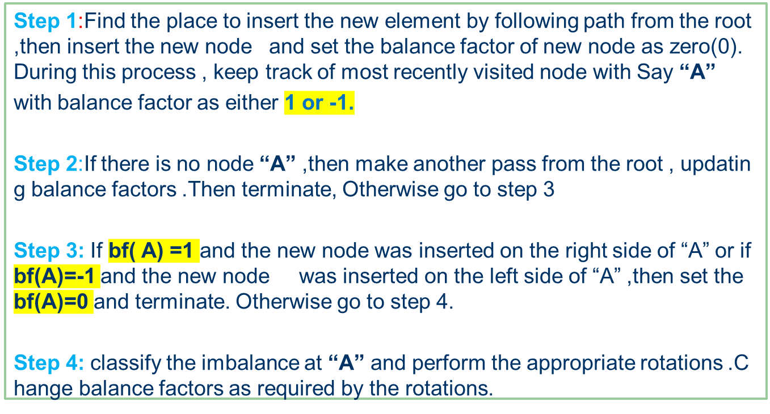
In an AVL tree, the insertion operation is performed with O(log n) time complexity. In AVL Tree, new node is always inserted as a leaf node. The insertion operation is performed as follows...

Slide 15
Inserting into an AVL Search Tree
Insert(9)
-1
10
1
7
1
40
0
3
0
8
1
30
45
-1
0
0
0
2
5
-1
20
0
35
60
0
25
Where is 9 going to be inserted into?
After the insertion, is the tree still an AVL search tree? (i.e., still balanced?)

Slide 16
Inserting into an AVL Search Tree
Insert(9)
-1
10
0
7
1
40
0
3
8
-1
1
30
45
-1
0
0
0
0
2
5
9
-1
20
0
35
60
0
25
Where is 9 going to be inserted into?
After the insertion, is the tree still an AVL search tree? (i.e., still balanced?)

Slide 17
Inserting into an AVL Search Tree
Insert(1)
-1
10
1
7
1
40
0
3
0
8
1
30
45
-1
0
0
0
2
5
-1
20
0
35
60
0
25
Where is 9 going to be inserted into?
After the insertion, is the tree still an AVL search tree? (i.e., still balanced?)

Slide 18
Inserting into an AVL Search Tree
LL Imbalance
LL Rotation(Right Rotatin)
Insert(1)
-1
10
A
2
7
1
40
B
1
3
0
8
1
30
45
-1
1
0
0
2
5
-1
20
0
35
60
0
0
1
25
LR Imbalance
Where is 9 going to be inserted into?
After the insertion, is the tree still an AVL search tree? (i.e., still balanced?)

Slide 19
Inserting into an AVL Search Tree
Insert(27)
-1
10
1
7
1
40
0
3
0
8
1
30
45
-1
A
0
0
0
-1
0
2
5
20
35
60
0
25
B
15

Slide 20

Inserting into an AVL Search Tree
RR Imbalance
RR rotation(Left Rotation)
Insert(27)
-1
10
1
7
1
40
0
3
0
8
1
30
45
-1
A
0
0
0
2
5
-2
20
0
35
60
B
-1
25
27
0
RL Imbalance
Where is 9 going to be inserted into?
After the insertion, is the tree still an AVL search tree? (i.e., still balanced?)

Slide 21
Imbalance Types
After an insertion, when the balance factor of node A is –2 or 2, the node A is one of the following four imbalance types
LL: new node is in the left subtree of the left subtree of A
LR: new node is in the right subtree of the left subtree of A
RR: new node is in the right subtree of the right subtree of A
RL: new node is in the left subtree of the right subtree of A

Slide 22
Rotation
Definition
To switch children and parents among two or three adjacent nodes to restore balance of a tree.
A rotation may change the depth of some nodes, but does not change their relative ordering.

Slide 23
Left Rotation
Definition
In a binary search tree, pushing a node A down and to the left to balance the tree.
A's right child replaces A, and the right child's left child becomes A's right child.
A
9
15
Left Rotation
4
15
9
22
12
22
4
12

Slide 24
Right Rotation
Definition
In a binary search tree, pushing a node A down and to the right to balance the tree.
A's left child replaces A, and the left child's right child becomes A's left child.
A
15
9
Right Rotation
9
22
4
15
4
12
12
22

Slide 25
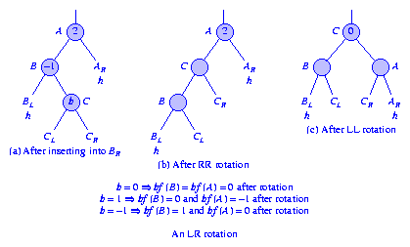
LR Rotation
Single and Double Rotations
Single rotations: the transformations done to correct LL and RR imbalances
Double rotations: the transformations done to correct LR and RL imbalances
The transformation to correct LR imbalance can be achieved by an RR rotation followed by an LL rotation as shown below
Figure (b) shows the tree after an RR rotation at vertex B
Figure (c) shows the result of performing an LL rotation at vertex A of the tree of Figure (b).
The resulting tree is the same as that shown in Figure (c).

Slide 26
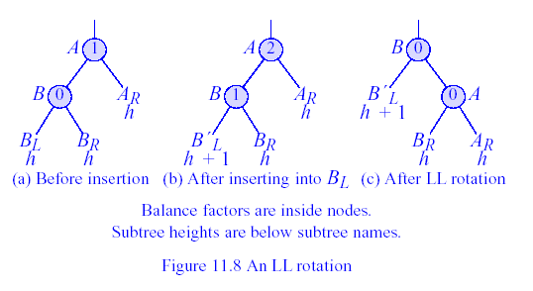
An LL Rotation
Figure An LL Rotation

Slide 27
An LL Rotation
Figure An LL Rotation
1
1
1
100
100
0
100
1
A
2
0
0
50
200
25
0
50
200
1
200
0
B
0
1
0
25
0
75
0
10
0
50
0
0
25
0
75
0
150
300
150
300
150
300
1
0
0
0
0
0
10
40
5
0
10
40
75
40
0
5

Slide 28
LR Rotation

Slide 29
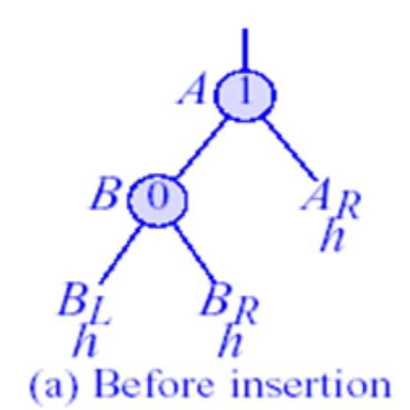
An LR Rotation
1
1
1
100
100
2
100
A
2
1
A
0
0
1
50
200
-1
50
200
100
50
0
200
-1
0
0
0
0
B
25
0
0
0
75
0
40
0
0
75
150
300
40
150
300
0
-1
200
25
0
75
0
0
0
0
150
300
1
25
25
50
150
300
0
0
10
40
B
0
10
10
0
0
40
35
0
0
35
75
10
35
1
0

Slide 30
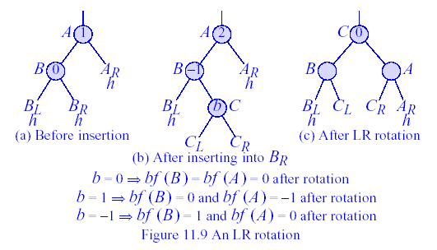
An LR Rotation
Figure An LR Rotation
1
1
1
100
2
100
100
1
A
0
0
0
50
0
50
200
40
0
200
-1
0
-1
200
1
B
0
0
0
0
25
0
0
0
75
150
300
25
50
75
0
150
0
40
150
300
300
0
0
0
0
25
0
35
0
10
35
75
10
40
10

Slide 31
An LR Rotation
Figure An LR Rotation
1
1
1
100
100
0
100
1
A
2
0
0
50
0
200
50
200
40
0
-1
0
-1
200
0
B
25
0
0
0
25
0
0
0
75
150
300
25
50
75
0
150
300
0
0
150
300
0
1
0
0
0
10
40
10
35
75
10
40
0
35

Slide 32
LR Rotation
Figure (b) shows the tree after an RR rotation at vertex B
Figure (c) shows the result of performing an LL rotation at vertex A of the tree of Figure (b).
The resulting tree is the same as that shown in Figure (c).

Slide 33
RR Rotation
-2
A
B
-1
A
1
B
B
ALh
ALh
-1
A
0
0
RR Rotation
BRh
BLh
BRh
BL _{h}
BR` _{h+1}
ALh
BLh
RR imbalance

Slide 34
Inserting into an AVL Search Tree
-2
A
B
-1
A
1
B
B
ALh
ALh
-1
A
0
0
RR Rotation
BRh
BRh
BL _{h}
BR` _{h+1}
ALh
BLh
BLh
Insert(27)
-1
10
1
7
1
40
0
3
0
8
1
30
45
-1
0
0
0
1
5
-1
20
0
35
60
0
25

Slide 35
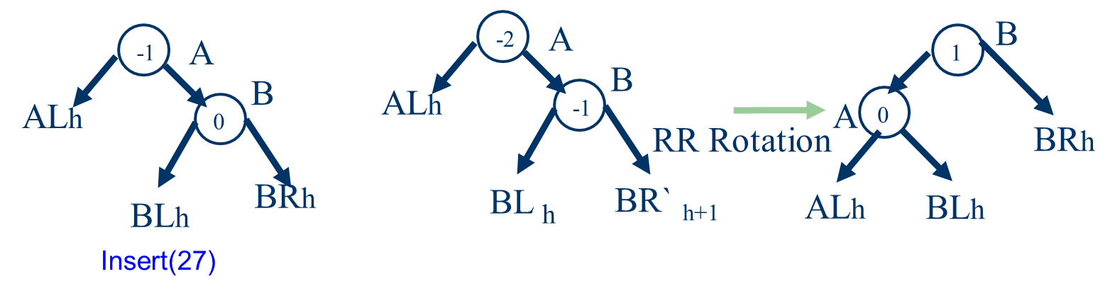
Inserting into an AVL Search Tree
-1
10
1
7
1
40
0
3
0
8
1
30
45
-1
0
0
0
1
5
20
0
35
60
-2
-1
25
27
0

Slide 36
After RR Rotation
-1
10
1
7
1
40
0
3
0
8
1
30
45
-1
0
0
0
1
5
0
25
0
35
60
0
0
20
27
After the RR rotation, is the resulting tree an AVL search tree?

Slide 37
RL Imbalance
C
-1
A
-2
A
-2
A
0
AL h
0
B
AL h
1
B
C
A
AL h
B
C
B
BL h
BR h
BR h
AL h
CL
CR
BR h
CL
CL
CR
CR
BR h

Slide 38
C
-1
A
-2
A
-2
A
0
A
0
B
ALh
1
B
C
ALh
B
ALh
C
B
BLh
BRh
BRh
CL
CR
BRh
CL
CL
CR
CR
BRh

Slide 39
Insert 15
0
5
-1
5
-1
-1
-1
7
2
7
2
-1
1
4
6
0
9
-2
1
4
6
0
9
1
1
0
0
16
0
3
0
16
1
3
0
0
15
0
0
-1
5
5
7
-1
-1
-1
2
2
7
A
0
1
4
6
0
9
C
1
1
4
6
0
C
1
15
0
0
3
15
0
B
0
3
0
A
9
16
B
0
16

Slide 40
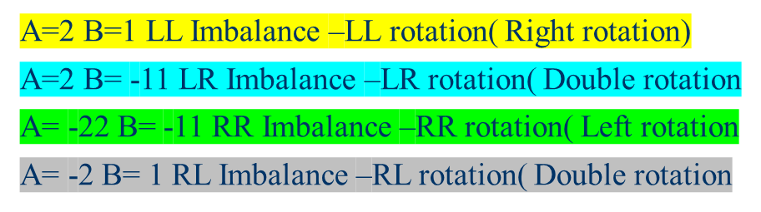
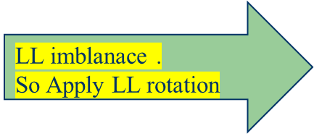
Insert following elements into an AVL 3,2,1,4,5,6,7,16,15
Step 1:insert(3)
0
3
Step 2:insert(2)
A
1
3
2
0
Step 3:insert(1)
A
2
3
0
B
1
B
2
2
0
A
0
3
1
1
0

Slide 41
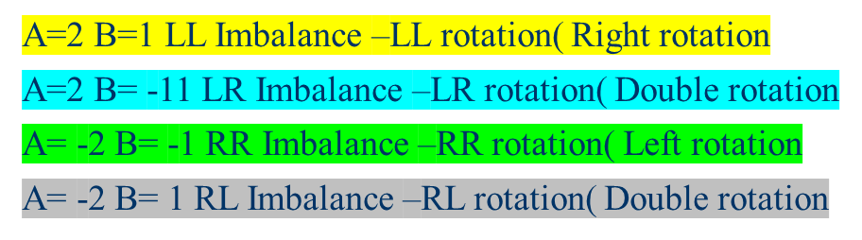
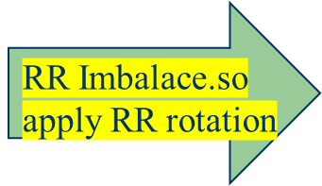
Insert following elements into an AVL 3,2,1,4,5,6,7,16,15
Step 3:insert(4)
2
-1
0
3
1
-1
0
4
Step 4:insert(5)
2
-1
-1
2
0
A
3
0
4
B
1
-2
1
0
B
A
-1
4
3
0
0
5
0
5

Slide 42
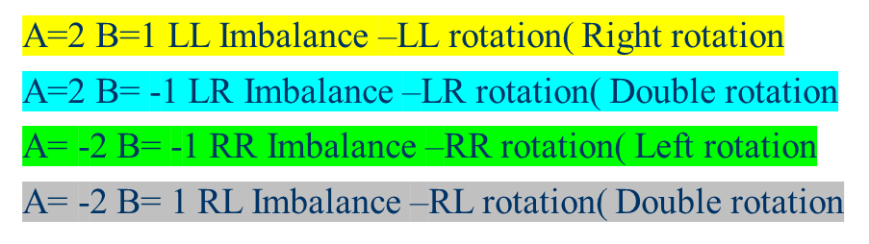
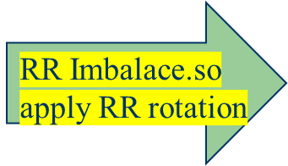
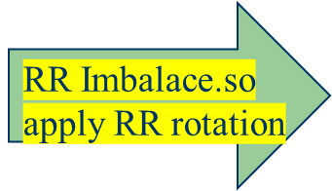
Insert following elements into an AVL 3,2,1,4,5,6,7,16,15
Step :insert(6)
A
2
-2
B
4
0
B
-1
A
0
0
4
2
-1
1
5
3
-1
0
3
6
0
5
1
0
0
6
Step :insert(7)
0
0
4
0
4
0
0
-2
A
2
0
2
B
5
6
B
A
0
6
0
3
5
7
1
3
1
0
0
0
0
-1
7
0

Slide 43
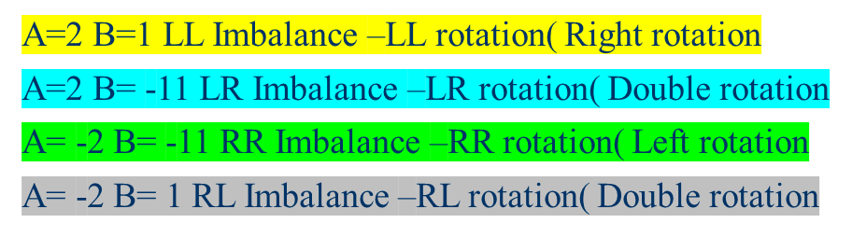


Insert 16
-1
4
0
-1
2
0
4
-1
6
0
A
A
-1
1
2
0
3
5
7
-2
6
1
0
0
B
0
3
5
7
-1
C
15
1
0
0
16
0
4
-1
16
Insert 15
0
2
-1
4
-1
A
6
0
C
2
-1
0
3
5
15
0
1
0
0
A
6
B
A
0
3
-2
A
16
1
0
5
7
0
7
0
0
B
C
16
1
0
15

Slide 44
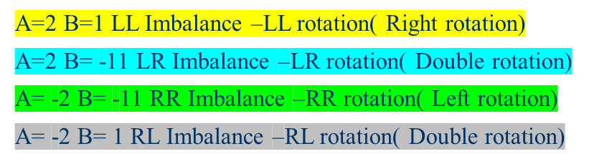
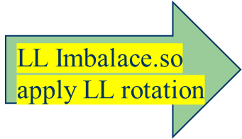
Insert following elements into an 20,10,5,30,40,3,4,25,23,27,56
Step 1:insert(20)
0
20
Step 2:insert(10)
1
20
0
10
Step 3:insert(5)
2
20
A
1
10
B
0
B
10
0
A
5
0
0
5
20

Slide 45
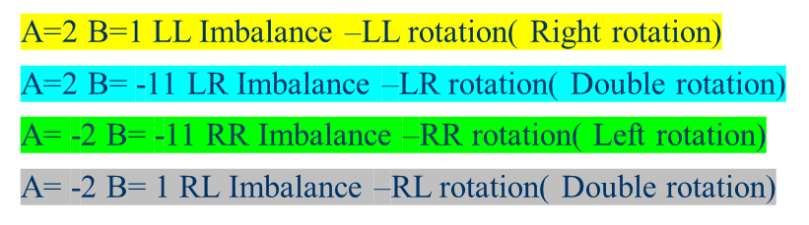

Insert following elements into an 20,10,5,30,40,3,4,25,23,27,56
Step 4:insert(30)
-1
10
0
-1
5
20
0
30
Step 5:insert(40)
-1
-1
10
A
10
0
-2
B
5
20
0
30
0
B
5
-1
30
20
0
40
0
0
A
40

Slide 46
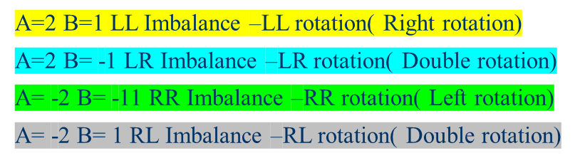
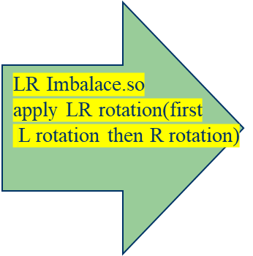
Insert following elements into an 20,10,5,30,40,3,4,25,23,27,56
Step 6:insert(3)
0
10
1
30
0
5
0
20
0
40
0
3
Step 7:insert(4)
0
10
0
0
2
0
10
5
30
10
A
-2
30
0
c
0
A
5
0
30
0
-1
20
0
40
0
4
3
c
0
A
B
4
20
40
0
4
3
B
5
20
0
40
c
0
B
3
0
0
B

Slide 47

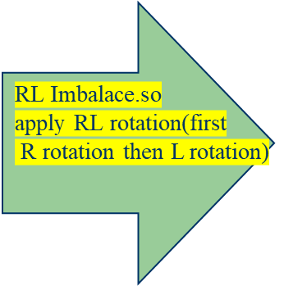
Insert following elements into an 20,10,5,30,40,3,4,25,23,27,56
Step 7:insert(25)
-1
10
-1
0
30
1
10
4
-1
0
30
1
3
5
20
0
40
4
0
0
c
0
25
0
3
5
23
0
40
Step 7:insert(23)
0
0
-1
A
20
25
B
-1
0
0
10
10
0
30
1
0
1
4
4
30
3
5
20
-2
0
40
5
20
-2
0
40
A
3
A
0
0
B
0
0
B
25
1
23
c
c
0
23
25

Slide 48
Insert following elements into an 20,10,5,30,40,3,4,25,23,27,56
Insertion of 27
-1
-1
-1
10
0
10
c
A
10
0
25
0
30
2
A
4
4
0
2
B
0
4
30
1
A
B
3
5
23
30
3
5
23
-1
0
40
3
5
25
-1
40
0
0
0
0
c
c
27
40
-1
0
0
20
20
25
0
0
0
B
23
27
Then R rotatin
0
27
0
20
LR Imbalance. Apply L rotation
Insertion of 56
B
0
A
--2
25
A
-1
10
-1
0
30
B
10
0
25
-1
4
RR imbalance.
Apply RR rotation
0
1
40
-1
4
23
27
1
0
3
5
23
30
0
56
0
0
3
5
20
40
-1
0
0
0
20
27
0
0
56
0

Slide 49
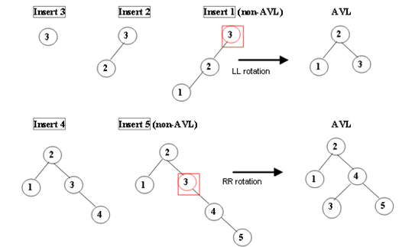
Example for insertion into an AVL

Slide 50
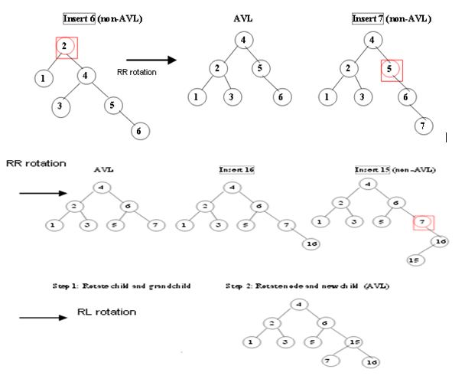

Slide 51
Example for insertion into an AVL
1)Insert “JAN”
2)Insert “FEB”
3)Insert “MAR”
JAN
0
1
JAN
0
JAN
0
0
FEB
0
FEB
MAR
4)Insert “APR”
5)Insert “MAY”
6)Insert “JUN”
1
0
JAN
JAN
0
JAN
1
0
1
1
-1
0
FEB
MAR
FEB
MAR
FEB
MAR
0
0
0
0
0
0
APR
APR
MAY
APR
JUN
MAY

Slide 52
6)Insert “JUL”
6)Insert “AUG”
6)Insert “AUG”
LR Rotation
-1
JAN
-1
-1
JAN
JAN
1
1
2
0
1
1
FEB
MAR
FEB
MAR
AUG
MAR
0
0
0
1
0
0
-1
0
1
MAY
APR
JUN
APR
JUN
MAY
APR
FEB
JUN
MAY
0
0
0
JUL
JUL
0
JUL
AUG
LR imbalance

Slide 53
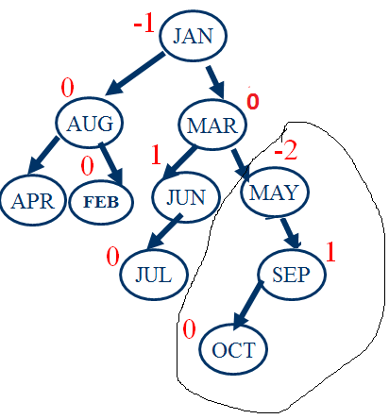
7)Insert “OCT”
6)Insert “SEP”
-1
JAN
0
0
AUG
MAR
0
1
-1
0
0
APR
FEB
JUN
MAY
0
0
JUL
SEP
RL imbalance

Slide 54
RL rotation
Insert NOV
-1
JAN
-2
JAN
0
0
0
-1
AUG
MAR
AUG
MAR
1
0
1
1
0
0
APR
FEB
JUN
OCT
APR
FEB
JUN
OCT
0
0
-1
0
0
0
JUL
MAY
SEP
JUL
MAY
SEP
0
NOV
RR Imbalance

Slide 55
RR Rotation
0
MAR
1
0
JAN
OCT
1
-1
0
0
AUG
JUN
MAY
SEP
0
0
0
APR
FEB
JUL
0
NOV
RR Imbalance

Slide 56
Insert “DEC”
1
MAR
1
1
JAN
OCT
1
-1
0
-1
AUG
JUN
MAY
SEP
0
1
APR
FEB
JUL
0
NOV
0
DEC

Slide 57
Deletion from an AVL
Deletion of 3
1
10
q
q
0
10
1
7
0
40
0
0
7
40
0
3
q
q
Deletion of 30
10
0
-1
10
0
7
0
40
0
7
1
40
0
q
q
30
-1
10
0
10
Deletion of 7
0
0
0
40
7
40

Slide 58
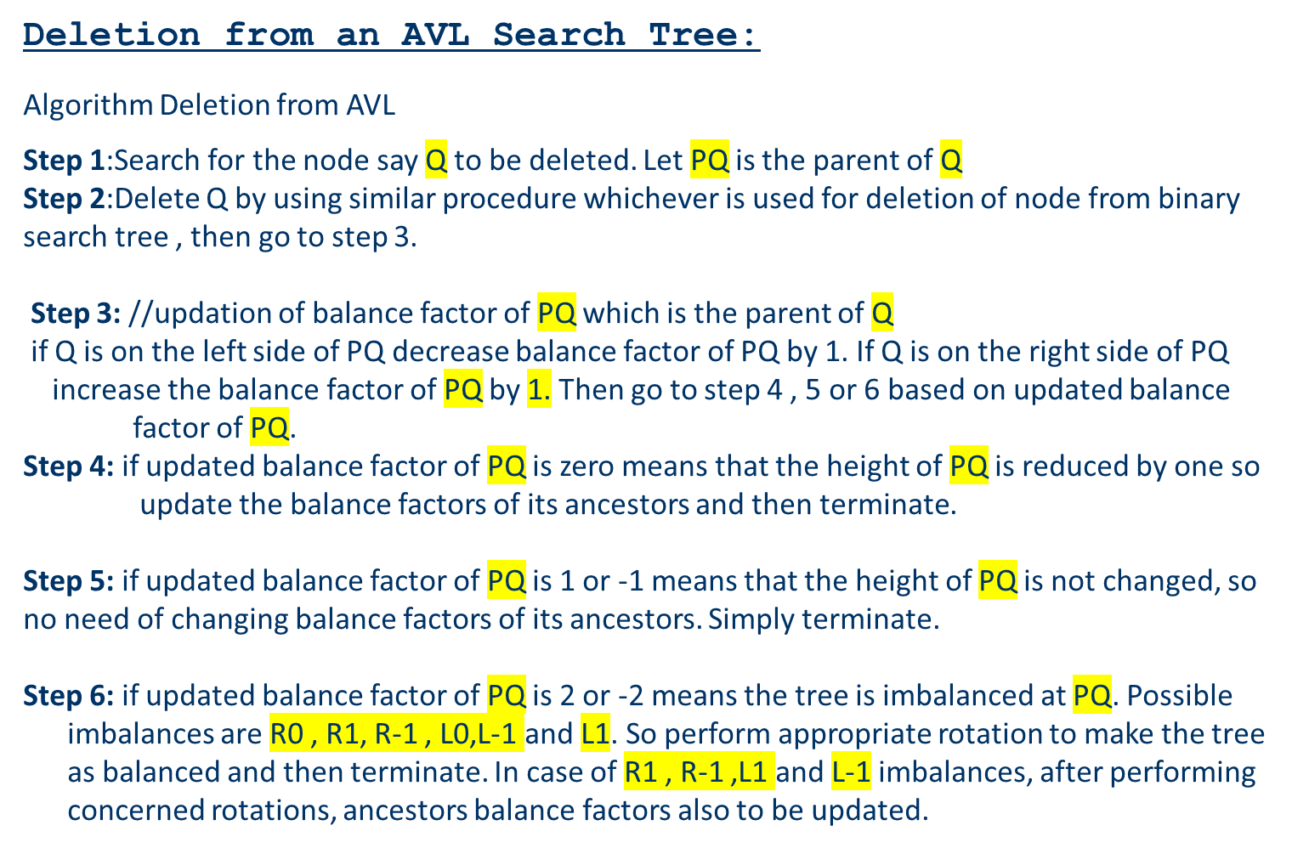

Slide 59
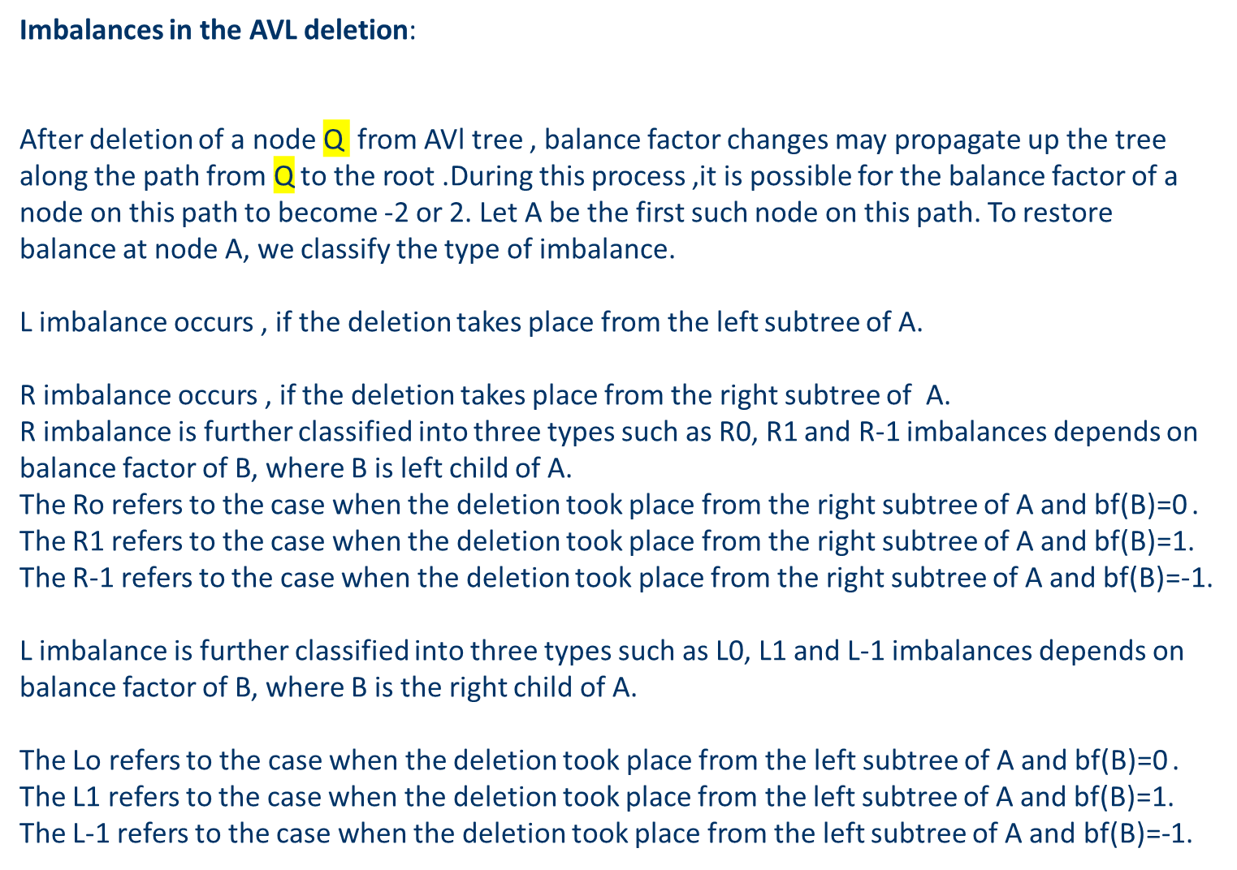

Slide 60
1
10
0
10
Deletion of 40
0
7
0
40
0
7
A
-2
10
-1
10
Deletion of 7
B
0
7
1
40
1
40
35
0
35
0

Slide 61
A
2
10
1
10
Deletion of 40
-1
7
0
40
-1
7
0
0
9
9

Slide 62
Deletion from an AVL Search Tree
Deletion of a node may also produce an imbalance
Imbalance incurred by deletion is classified into
the types R0, R1, R-1, L0, L1, and L-1
Rotation is also needed for rebalancing
Read the observations after deleting a node from an AVL search tree

Slide 63

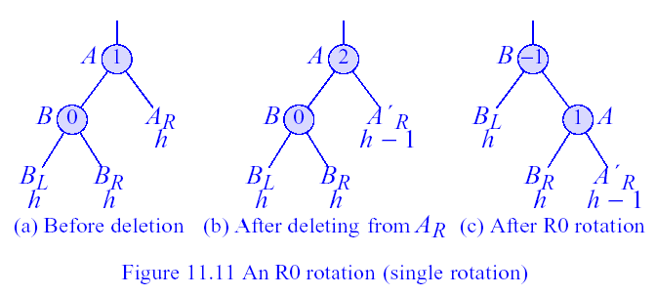
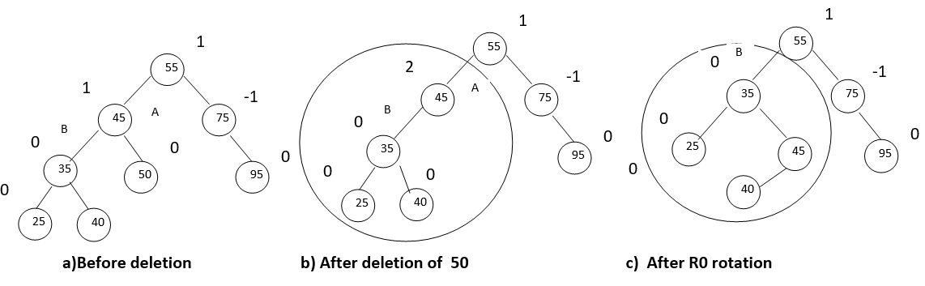
An R0 Rotation
Figure : An R0 rotation (single rotation)

Slide 64

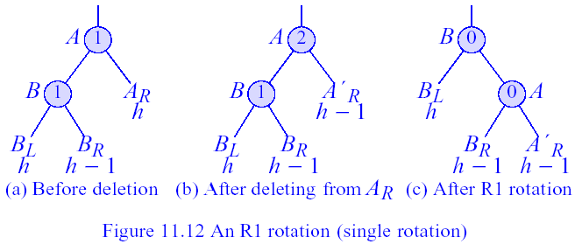
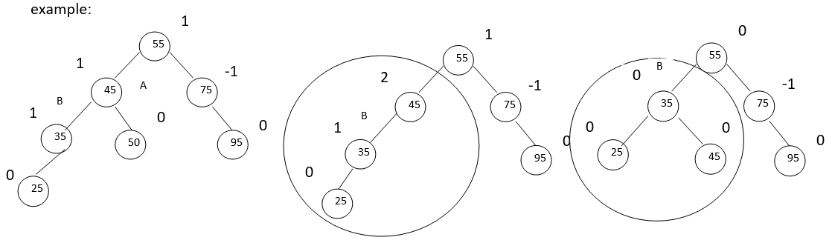
An R1 Rotation
Figure .An R1 rotation (single rotation)

Slide 65
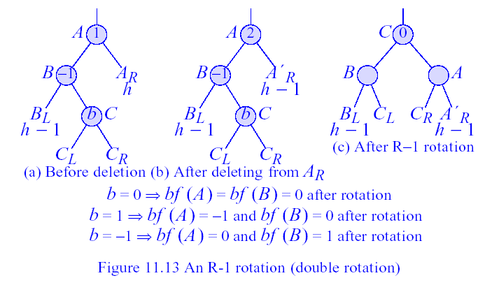
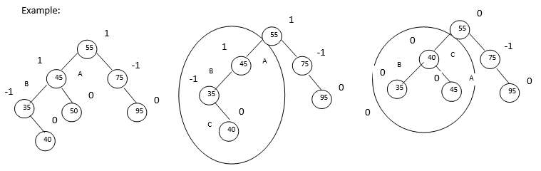
An R-1 Rotation
Figure An R-1 rotation (double rotation)

Slide 66

An R-1 Rotation
Figure An R-1 rotation (double rotation)

Slide 67

An L0 Rotation
-2
A
B
-1
A
1
B
B
ALh
Al_{h-1}
0
A
-1
0
RR Rotation
BRh
BLh
BRh
BL _{h}
BR _{h}
Al_{h-1}
BLh
Delete 5
A
-1
-2
10
10
B
0
0
7
0
40
1
7
40
-1
0
3
0
8
1
30
45
-1
3
0
8
1
30
45
-1
-1
0
0
-1
0
5
0
25
0
35
43
60
25
35
43
60
0
0
0
0
0
0
0
65
0
20
27
65
20
27
Before delete
After delete

Slide 68
Apply
L0 Rotation
-2
A
B
10
B
40
-1
0
7
0
40
A
1
10
45
-1
0
0
1
-1
-1
60
3
8
30
45
43
0
0
-1
0
7
1
65
0
43
30
25
35
60
0
0
0
0
0
0
0
25
0
35
20
27
65
0
3
8
0
0
20
27

Slide 69

An L-1 Rotation
-2
A
B
-1
A
0
B
B
ALh
Al_{h-1}
-1
A
0
-1
RR Rotation
BRh
BLh-1
BRh
BL _{h-1}
BR_{h}
Al_{h-1}
BLh-1
Delete 5
-1
A
10
-2
B
10
1
-1
7
40
-1
0
7
40
-1
0
1
-1
3
8
30
45
3
0
0
8
1
30
45
-1
0
-1
5
0
25
27
43
60
-1
0
0
0
25
27
43
60
0
0
0
65
0
65

Slide 70
-2
10
A
B
0
-1
7
40
Apply L-1 Rotation
3
0
0
8
1
30
45
-1
-1
0
25
27
43
60
0
0
0
65
B
0
A
40
-1
0
10
45
0
-1
0
7
30
43
60
0
3
0
0
8
25
27
65
0
0
0

Slide 71

An L1 Rotation
-2
A
-2
A
-1
A
B
c
B
Al_{h-1}
1
Al_{h-1}
ALh
-1
B
c
1
_{CL}
c
BRh-1
BR _{h-1}
_{CR}
BR _{h-1}
_{CL}
_{CR}
_{CL}
_{CR}
c
0
A
B
Al_{h-1}
_{CL}
_{CR}
BR _{h-1}

Slide 72
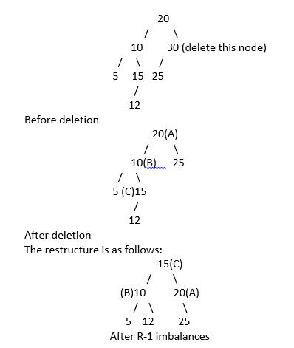

Slide 73
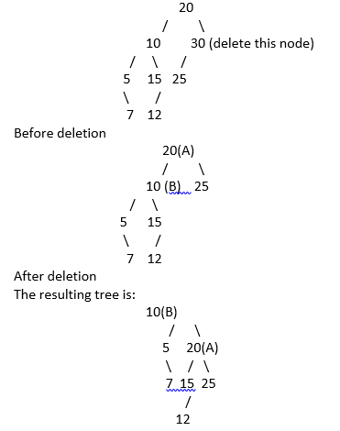


Slide 74
